Slide 1
Hacking Project 3
“#cheatersalwayswin
#losersnevercheat”
-Kevin

Slide 2
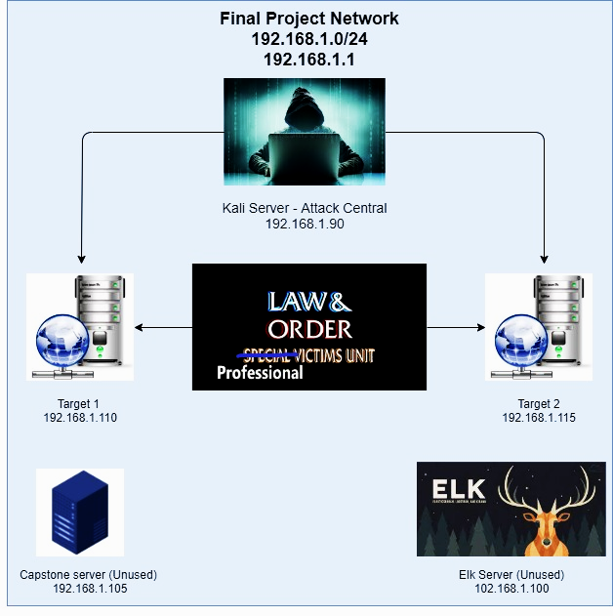
Network Topology
Network
Address Range: 192.168.1.0/24
Netmask: 255.255.255.0
Gateway:
192.168.1.1
Machines
IPv4: 192.168.1.110
OS: Debian GNU/Linux 8
Hostname: Target 1
IPv4: 192.168.1.115
OS: GNU/Linux 8
Hostname: Target 2
IPv4: 192.168.1.90
OS: Kali GNU/Linux Rolling
Hostname: Kali
IPv4: 192.168.1.100
OS: Linux- Ubuntu Version 18.04.4 LTS (Bionic Beaver)
Hostname: Elk

Slide 3
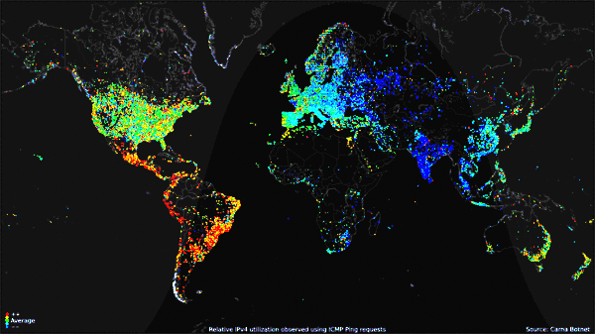
Carna Botnet
In 2012, a security researcher set out to see how many computers were running Telnet and using any default usernames and passwords. After successfully logging in with one of 4 combinations of defaults, admin/admin, admin/no password, root/root and root/no password on over 100,000 IPs, he created a program that would scan and find unprotected systems, upload the program, and use that system to scan for more systems (Automation). Eventually, this researcher scanned the entirety of the internet using its 420,000 machines.
https://darknetdiaries.com/transcript/13/,
Jack Rhysider

Slide 4
What does Telnet have to do with our attack?

Slide 5
Absolutely nothing!

Slide 6
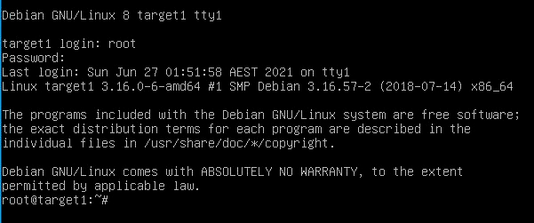
But default credentials played a huge role!
Default credentials are a real security issue, one that Target 1 suffers from.
root:toor

Slide 7
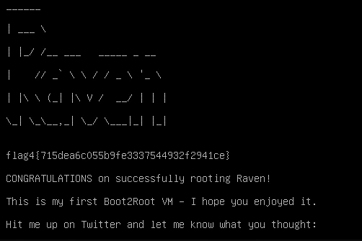
Now that we have root access...
We ls just for shiggles.
flag4.txt
Alright! cat flag4.txt

Slide 8
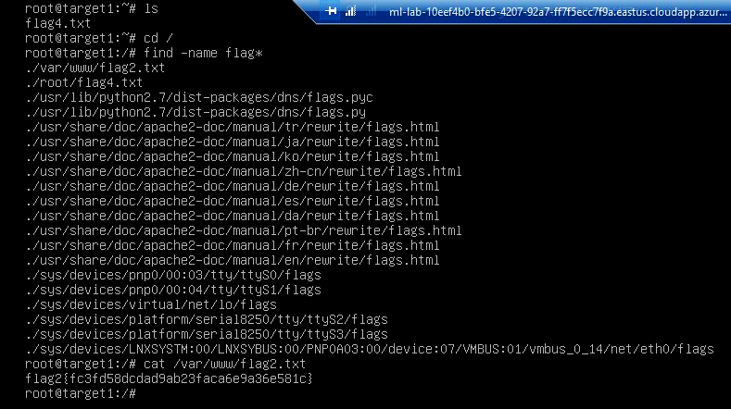
There are at least 4 flags...
and they all have the word “flag” in them!
So we decide to use the find command to search for them, but first we move into root directory so we can search the whole machine.
cd / | find -name flag*

Slide 9
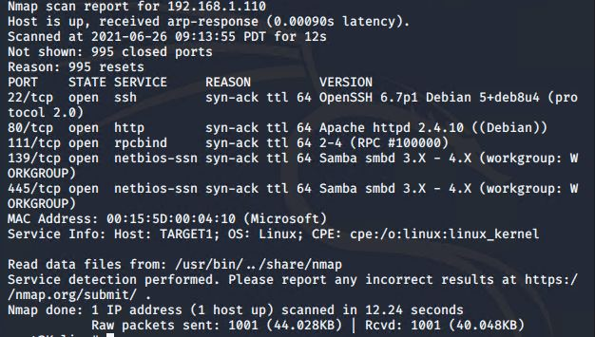
2 Flags Down, 2 To Go
We scan Target 1 to see what we can find.
nmap -sV -vv 192.168.1.110 (-sV detects the versions of services running)

Slide 10

Apache is a web server!
So we try going to the site!
Raven Security: http://192.168.1.110
Piddling around, we don’t see much.
But then...

Slide 11

Tyler remembers that Eden hacked HW10
Eden couldn’t find the answer on
Mary’s book, so she just inspected the
page source and found what the web
page was looking for as an answer.

Slide 12
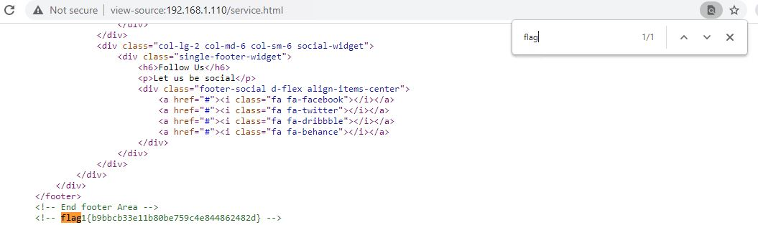
So he inspects each page’s source...
and searches for the word “flag”

Slide 13
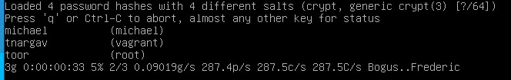
3 of 4 flags! Now to peek at the directions...
Step 4: Guess michael’s password. What’s the most obvious guess? Nothing is obvious to The Overthinkers.
Instead, Trumbo installs John the Ripper on Target 1 so he can just crack some hashes.
The Overthinkers’ arch nemesis has always been overthinking.
Also, turns out vagrant’s password has been tnargav this whole time!

Slide 14
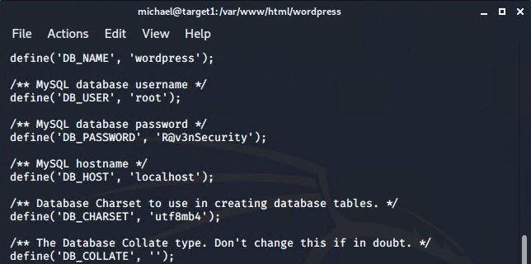
Time to find the MySQL database password
cat /var/www/html/wordpress/wp-config.php

Slide 15
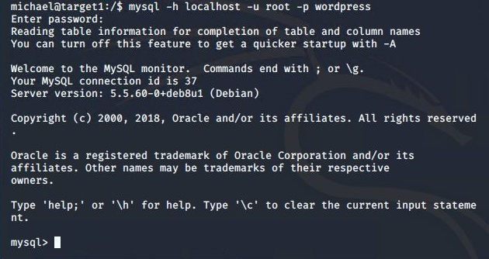
Let’s log in to mysql as root!

Slide 16
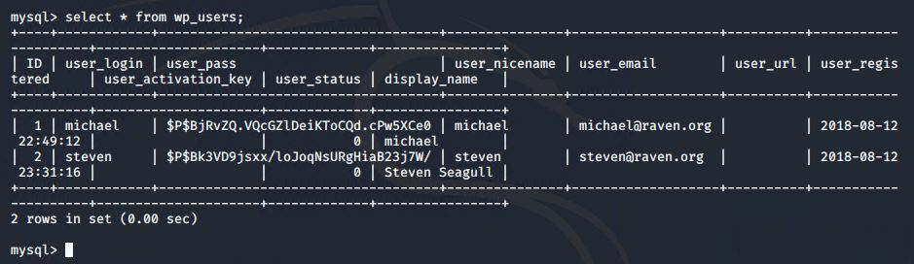
Take a dump
show tables;

Slide 17
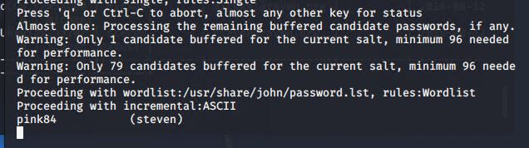
John, meet Steven
They talked for quite a while, but ultimately

Slide 18
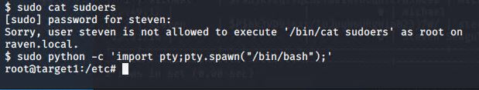
So we log in to Target 1 as Steven, for fun
And spend an hour trying to escalate to root, even though we exploited the default credentials at the start. Finally, with a lot of googling, we find this:
All because Steven has sudo permissions with the python folder.

Slide 19
But wait… Where is flag 3?
We scour Target 1 again, trying to find the flag we missed. We look over the instructions again, looking for clues. It only hints at 3 flags you can find by following the instructions. We inspect all the pages on the site again. Nothing.
If it is not on Target 1, not on Raven Security’s website, there’s only one other place it could be…

Slide 20
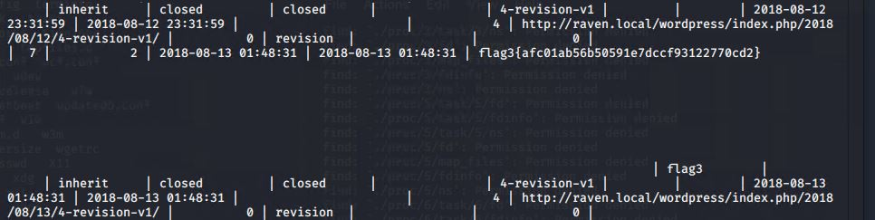
The SQL Database.
We search each database using select * from _____
And finally...

Slide 21
Critical Vulnerabilities: Target 1
Our assessment uncovered the following critical vulnerabilities in Target 1.
Vulnerability | Description | Impact
Default Login Credentials | Admin never changed default root credentials. | Easily allowed root access
Improper Error Handling | Error messages give information when an unforeseen problem occurs. | Error messages gave too much info away to attackers, allowing wpscan to enumerate users.
Weak Passwords / No Password Complexity Requirements. | No password complexity requirements set - no PAM or anything similar. No real security culture that mitigates Michael being a damned fool. | Allowed an attacker to brute force their way into the machine. It took mere moments to crack Michael’s password, in addition to being easily guessable.

Slide 22
Other Critical Vulnerabilities
Our assessment uncovered the following critical vulnerabilities in Targets 1 and 2.
Vulnerability | Description | Impact
Optionsbleed bug | Can accidentally leak data when processing an OPTIONS request | Can potentially see data meant to be secret, such as PII.
Samba is_known_pipename() Arbitrary Module Load | This module triggers an arbitrary shared library load vulnerability | Successfully exploiting this issue allows attackers to execute arbitrary code in the context of the affected application. Failed exploits will result in denial-of-service conditions.

Slide 23
Critical Vulnerabilities: Target 2
Our assessment uncovered the following critical vulnerabilities in Target 2.
Vulnerability | Description | Impact
Weak Passwords | Again, no password complexity requirements set - no PAM (pluggable authentication module) or anything similar. Vagrant:tnargav should not be allowed. | If an attacker would have used a tool to brute force in, it would not have taken long to break this password.
Credential Reuse | Using the same credentials for multiple machines/systems/sites. | Eventually allows us root access.

Slide 24


Slide 25
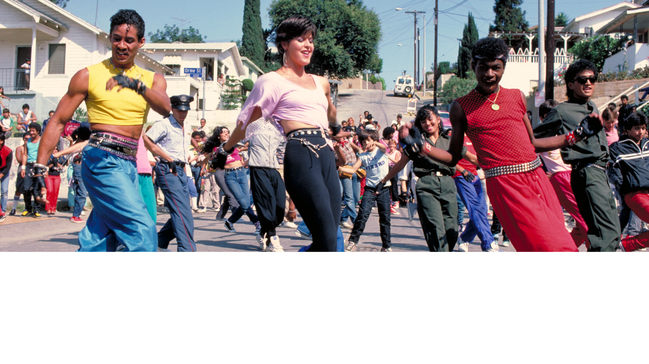
Target 2: Electric Boogaloo
This target appears much more difficult. For starters, there is no root:toor. Michael is no longer as dumb as a bag of rocks, and Steven has changed his password. The website has also sanitized the error messages so that attackers cannot enumerate users.

Slide 26
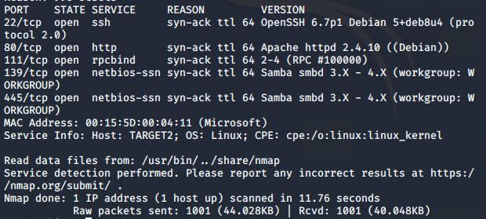
NMAP
nmap -sV -vvv --version-intensity 9 192.168.1.115

Slide 27

Enumerate with nikto
nikto -C all -h 192.168.1.115
url/sss/
url/img/
url/manual/
url/manual/images
url/.DS_Store
url/icons/README

Slide 28

Enumerate with gobuster
gobuster -w /usr/share/wordlists/dirbuster/directory-list-2.3-medium.txt dir -u 192.168.1.115
/wordpress
/js
/vendor
/fonts
/server-status

Slide 29
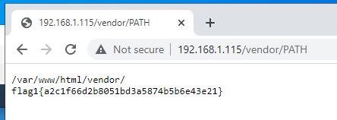
Flag 1
Flag: 1 is located in this directory on the website

Slide 30
Trumbo falls flat on his face.
Next step is to research vulnerabilities associated with the programs found in the nikto and gobuster enumerations.
searchsploit Apache 2.4.10
searchsploit SSH 6.7
Decided to target Apache, but…
“Use the provided exploit.sh to exploit this vulnerability by opening an Ncat connection to your Kali VM”
He could not, and still cannot, find this “provided” script.

Slide 31
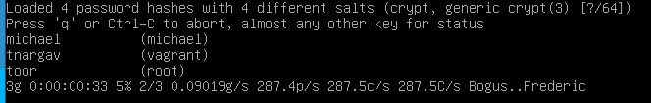
But he suddenly remembered there is one other user account...
There’s no way…
ssh vagrant@192.168.1.115
password: tnargav

Slide 32
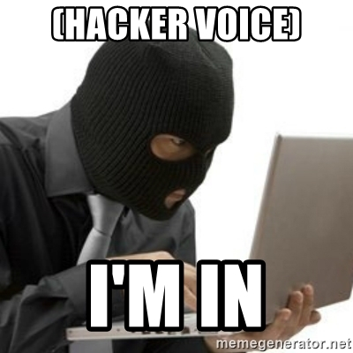

Slide 33
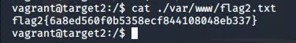
Flag 2
So he skips down to step 7:
“find a flag in /var/www”

Slide 34

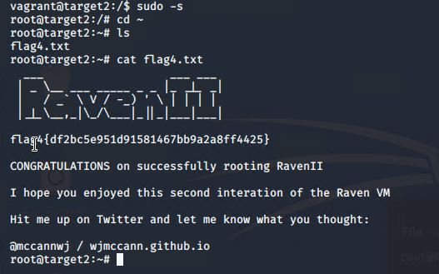
I am Root.
Vagrant has permissions to switch to root using sudo -s
The -s option runs the shell specified by the SHELL environment variable if it is set or the shell as specified in the password database…. If no command is specified, an interactive shell is executed.

Slide 35
Now that I am Root, time to find Flag 3.
“In a credential reuse attack, the attacker is able to obtain valid credentials for one system and then tries to use the same credentials to compromise other accounts/systems.”

